Slide 1
Interpretability of LLm’s using
Route Sparse Autoencoders
Presented by:
422126 – Chappidi Pavitra Subhasri
422231 – Paivula KrishnaPriya
422161 – Jitendra Pachar
Supervised by :
Dr. K. Hima Bindu

Slide 2
Abstract
Mechanistic interpretability aims to understand how large language models (LLMs) process and represent information internally.
Sparse Autoencoders (SAEs) have proven effective for extracting interpretable and monosemantic features from model activations.
However, conventional SAEs operate on a single layer, missing cross-layer dependencies.
Route Sparse Autoencoder(RouteSAE) introduces a routing mechanism with a shared SAE, enabling efficient, multi-layer feature extraction with higher interpretability and minimal parameter overhead.

Slide 3
Problem Statement
Traditional sparse autoencoders (SAEs) only work on one layer at a time.
Because of this, they can extract features only from that specific layer.However, in modern large language models, many important features appear across multiple layers, not just one.
Single-layer SAEs cannot detect these cross-layer patterns, so they miss many meaningful features.
As a result, existing SAEs are not enough for full interpretability or for controlling model behavior.
We need a new SAE design that can learn multi-layer features while still staying sparse and interpretable.
Such a model would allow better understanding of how the network thinks and give more accurate ways to steer its activations.

Slide 4
Objective
Goal: To create a new framework that can combine activations from multiple layers and To validate that the RouteSAE training objective converges correctly and produces high-quality, monosemantic features even with limited data
It must enable better feature extraction rather than single-layer analysis.
The method should avoid adding significant model complexity or increasing computational cost.
This allows understanding of model behavior.

Slide 5
What is a Sparse Autoencoder (SAE)?
Goal of an SAE
Decompose complex, dense LLM activations into interpretable features.
Convert dense activation vector x (polysemantic, hard to interpret) into a sparse feature vector z.
Each active feature ideally represents one meaningful concept → monosemanticity.
Why High Dimensionality (M >> d)?
Original activation x is polysemantic: each dimension mixes many concepts.
Simple thresholding cannot separate mixed concepts → information loss.
SAEs create an overcomplete feature space (more features than original dimensions ---- M >> d).
Large M allows dedicated neurons for specific concepts (e.g., “Red”, “Green”, “Past tense”, “Negation”).

Slide 6


Working of Vanilla SAE
ENCODER
DECODER
$$z=ReLu\left(W_{\text{enc}}\left(x−b_{\text{pre}}\right)\right)$$
$$\hat{x}=W_{\text{dec}}z+b_{\text{pre}}$$
Centers the activation: removes the bias term b pre.
Projects the activation into a high-dimensional feature space.
Applies a nonlinearity (ReLU)
Produces a sparse, interpretable feature vector z.
Reconstructs the original activation using
Checks whether the sparse features in z capture the meaning of x.
Ensures good reconstruction and verifies interpretability.

Slide 7
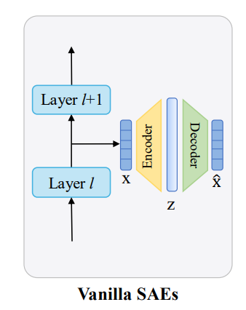

Model Architecture of Vanilla SAE
Learning Objective
Minimize a loss composed of two parts:
1. Reconstruction Loss
$L=∥ x−\hat{x} ∥_{2}^{2}$
Encourages the model to accurately reconstruct the original activation.
Ensures the learned features preserve important information.
2. Sparsity Loss (L1)
Penalizes non-zero entries in z.
Used in early SAEs to enforce sparsity in the feature vector.

Slide 8

Topk SAE
Problem with Vanilla SAE(Feature Shrinkage)
L1 penalty + ReLU pushes useful feature activations toward zero.
Results in poor reconstruction and weak interpretability.
TopK SAE
Replace ReLU + L1 with:
→ keeps only the K strongest features.
Benefits:
Exact control of sparsity.
Selected features retain strong activation values (no shrinkage).
Much better reconstruction + monosemanticity.
$$z= \text{TopK}\left(W_{enc}\left(x−b_{pre}\right)\right)$$

Slide 9
Why RouteSAE? The Limitation of Single-Layer SAE
Normal SAEs (including TopK SAE) are trained on only one layer.
They capture either low-level features (early layers) or high-level features (deep layers), but not both.
Important LLM concepts appear at different layers, so single-layer methods miss many features.
We need a method that can learn multi-layer features efficiently while maintaining one shared interpretability space.
RouteSAE solves this using a router + one shared TopK SAE.

Slide 10
Introduction to Route Sparse Autoencoder
To address these limitations, RouteSAE is proposed with the key aims of overcoming the single-layer constraint of standard SAEs, improving feature interpretability and monosemanticity, and ensuring a scalable and efficient architecture for large language models.
This is achieved through a novel design featuring a router module combined with a shared SAE.
The router dynamically assigns importance weights to activations across different layers, while a shared TopK SAE functions as a unified encoder-decoder to create sparse representations.
This integrated approach enables RouteSAE to effectively learn multi-layer, interpretable features while rigorously maintaining computational efficiency.

Slide 11
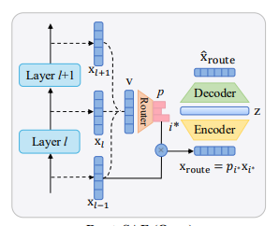
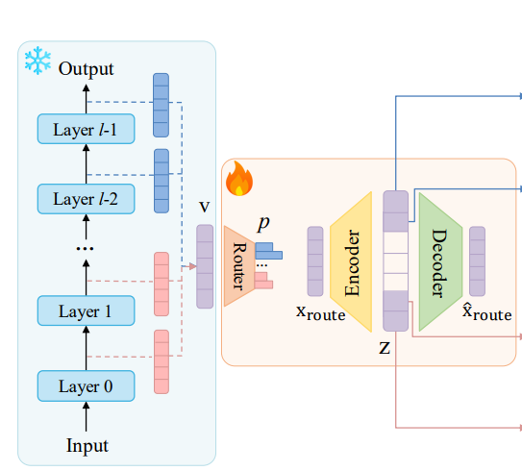
MODEL ARCHITECTURE OF ROUTE SAE
Figure 1: MODEL ARCHITECTURE OF ROUTE SPARSE AUTOENCODER

Slide 12

Step 1: Router Collects Information (Sum-Pooling)
The weights of LLM are frozen so that it doesn’t get effected by backpropagation due to reconstruction loss.
Router takes activations from L layers:
x₀, x₁, …, xₗ₋₁, each ∈ ℝᵈ
Naive approach: concatenating all layers ⇒ very large input (L × d).
Smart approach: Sum Pooling
Compute a summary vector:
This reduces all layers into one compact representation.
The summary vector v represents global activity across all layers.
$$v=\sum_{i=0}^{L−1}{x_{i}}, x_{i}∈R^{d}$$

Slide 13



Step 2: Router Finds the Most Important Layer
A learnable weight matrix $W_{\text{router}}$maps this summary vector to layer relevance scores:
Each element $α_{i}$corresponds to how much the router thinks layer $i$is relevant for the current input.
Softmax — Normalized Layer Probabilities
To turn these scores into a probability distribution over layers:
Now each $p_{i}≥0$, and $\sum_{i}{p_{i}}=1$.
Interpretation:
$p_{i}$≈ “how much attention to pay to layer i”
Similar to attention weights in Transformers.
$$α=W_{\text{router}}v$$
$$p_{i}=\frac{e^{α_{i}}}{\sum_{j}{e^{α_{j}}}}$$

Slide 14


STEP 3:DYNAMIC ROUTING
Select best layer for token
The router then selects or weights the activations accordingly:
This routed activation $x_{\text{route}}$ is what the shared Sparse Autoencoder (SAE) uses to extract features.
$$i^{∗}=\arg{\max_{i}{p_{i}}}, i=0,1,…,L−1.$$
$$x_{route}=p_{i^{∗}}∗x_{i^{∗}}$$

Slide 15



STEP 4:Shared TopK SAE Processes Routed Activation
The latent representation z and the reconstruction x̂ are calculated as follows:
Finally, we minimize the reconstruction MSE:
This objective function jointly trains the router and the shared TopK SAE, ensuring efficient and adaptive feature extraction across multiple layers.
$$z_{route}=\text{TopK}\left(W_{enc}\left(x_{route}−b_{pre}\right)\right)$$
$$\hat{x_{route}}=W_{dec}z_{route}+b_{pre}$$
$$L=∥x_{\text{route}}−{\hat{x}}_{\text{route}}∥_{2}^{2}$$

Slide 16
Main Advantages of RouteSAE
Single Shared TopK SAE for all layers
Far more efficient than training separate SAEs for every layer.
Creates a Unified Feature Space
Same feature neuron represents the same concept across layers.
Router selects the correct layer’s activation
Routes the most relevant layer into the shared feature dictionary.
Improves interpretability and consistency
Features align across the whole model.
Enables multi-layer feature extraction with minimal parameters
Allows precise causal experiments
(e.g., modify or disable specific features at any layer).

Slide 17
Model and Dataset details
LLM used:Llama-3.2-1B-Instruct.
Number of layers :16
Input data: Input Data: Residual stream activations from middle layers [3 through 11]
Dataset used:OpenWebText2 (Gao et al., 2020)
→made use of 20000 documents for train,2000 for apply and 2000 for eval
Gpt-4o to assign interpretation scores and give explanations for a feature using a prompt

Slide 18

Hyperparameters
Model Dimensions:
  Hidden Size $\left(d_{model}\right)$= 2048
  Latent Size $\left(d_{sae}\right)$= 16384
Context Window: Max Sequence Length = 512 tokens
Hyperparameter | RouteSAE (Multi-layer) | Vanilla (Single-layer) | TopK (Single-layer)
Layer(s) Targeted | 9 Layers (Multi-Layer) | Layer 12 | Layer 12
Sparsity Parameter | k=64 | lambda=18 | k=64
Learning Rate | 5e-4 | 5e-4 | 5e-4
Batch Size | 16 | 8 | 8

Slide 19
Evaluation Metrics
KL Divergence:
This measures how much the model's output distribution changes when its original activations are replaced by the SAE's reconstructed ones. A lower value is better.
This indicates that the features extracted by RouteSAE are highly relevant for the language modeling task. The model can 'use' the reconstructed features from RouteSAE almost as effectively as its original activations.
Interpretation Score:
This measures how understandable and semantically meaningful the discovered features are when evaluated by a language model.
A higher value means the SAE is capturing clear, human-interpretable concepts rather than noisy or mixed patterns.
Norm MSE (Normalized Mean Squared Error):
This measures how accurately the SAE can reconstruct the model’s original activations.
A lower value means the SAE preserves more of the model’s information, ensuring the extracted features remain faithful to the underlying representation.

Slide 20
Results
Model Name | Norm MSE | KL Divergence | Interpretation Score
Vanilla SAE | 0.23 | 389 | 4.16
Topk SAE | 0.134 | 145 | 3.92
Route SAE | 0.145 | 118 | 4.38

Slide 21
Summary and Key Insights
RouteSAE achieves the lowest KL divergence (90), meaning it best matches the true activation distribution.
TopK SAE achieves the lowest reconstruction error (Norm MSE = 0.134) among all models.
Vanilla SAE performs the weakest on both metrics: highest KL divergence and highest MSE.
RouteSAE has the highest interpretation score (4.38), showing it produces the most interpretable features.
Overall, RouteSAE offers the best balance of reconstruction quality and interpretability compared to Vanilla and TopK SAEs.

Slide 22
Conclusion
RouteSAE overcomes the limitations of traditional SAEs by looking across multiple layers instead of just one, capturing a wider range of important features.
Its dynamic routing mechanism intelligently selects the layer with the most useful information, sending it to a single shared SAE for efficient feature extraction.
This design is far more scalable and lightweight than training separate SAEs for every layer, making it practical for real-world LLM interpretability.
RouteSAE produces a unified dictionary of high-quality, human-interpretable features, giving researchers a clearer view of how the model thinks internally.
Experiments show strong reconstruction accuracy and high interpretability, making RouteSAE a powerful tool for safer, more transparent, and more controllable LLMs.

Slide 23
References
Bricken et al., Sparse Autoencoders Find Highly Interpretable Features in Language Models, Anthropic, 2023.
Gao et al., Route Sparse Autoencoder to Interpret Large Language Models, arXiv:2503.08200, 2025.

Slide 24
THANK YOU

